Slide 1
Make - collocations
Teacher: Imma Pladevall
Bat
English

Slide 2
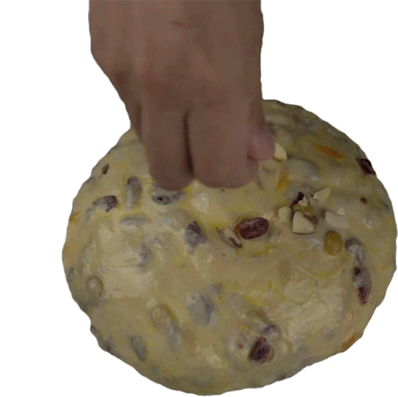
Make
p.imma.pladevall@manresasis.cat
Summary
Food and drink preparation
Arrangements and decisions
Speaking, sounds and relationships
Money

Slide 3

Make
p.imma.pladevall@manresasis.cat
Food and drink preparation
make breakfast, lunch or dinner
make a cake
make coffee
make a sandwich
make a snack

Slide 4

Make
p.imma.pladevall@manresasis.cat
Arangements and decisions
make an appointment
make plans
make a list
make a choice
make a decision
make a mistake

Slide 5

Make
p.imma.pladevall@manresasis.cat
Speaking, sounds and relationships
make a promise
make a phone call
make a joke
make a suggestion
make an excuse.
make a noise
make friends

Slide 6
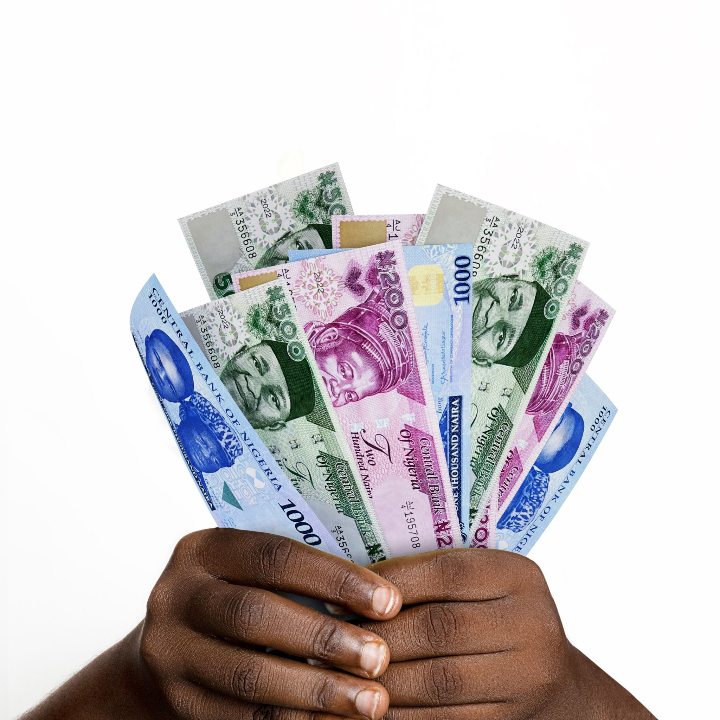
Make
p.imma.pladevall@manresasis.cat
Money
make a lot of money
make $10
make a living
make an investment

Slide 7
Make
p.imma.pladevall@manresasis.cat
Idioms
Make do with : Work with what we have
When you have no money, you need to make do with what you have.
make (-) capital out of something: use a situation to take advantage for yourself.
The opposition are trying to make capital of people’s discontent.
Make certain: make sure
Make certain that you lock the door when you leave.
Make common cause with someone: work with someone for a goal
Environmental activists are making common cause with local people to stop the forest from being cut.

Slide 8
Make
p.imma.pladevall@manresasis.cat
Idioms
Make conversation: talk to someone to be polite
My tailor has learned not to make conversation with my aunt. She is very talkative.
Make ends meet: manage to have enough money for everything you need
I had to work long hours to make ends meet that month.
make for somewhere/something : go towards somewhere
I’m tired, I’ll make for home soon
Make friends (with) : become friend
I made friends with her as soon as we met in the kindergarten
make fun: laugh at
People don’t like Paul much. He always makes fun of unfortunate people.

